Slide 1
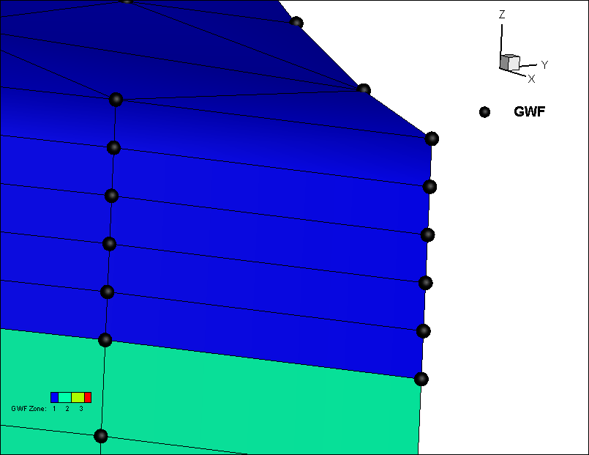
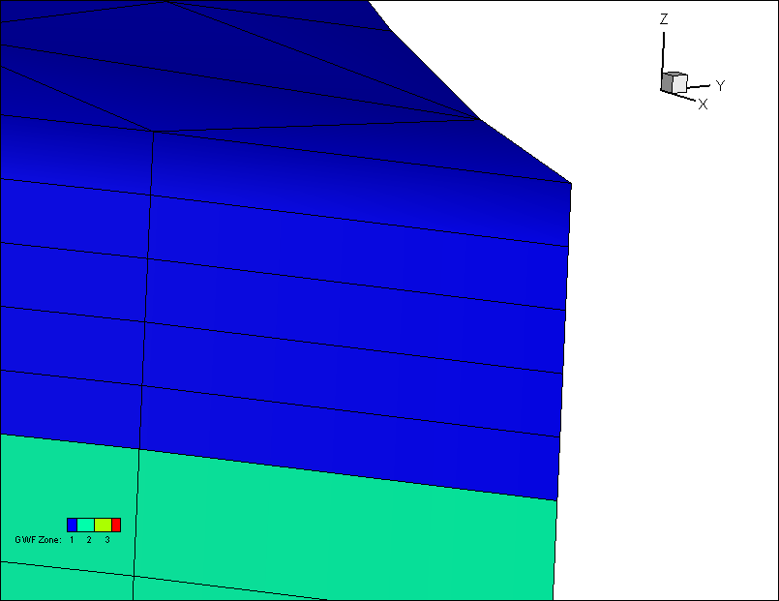
Meeting May 7, 2024
Implemented Method 1 for node-centred control volume approach
Method 1: half cell at top and bottom of domain
Can be plotted directly in Tecplot because number of cells equals number of nodes
Method 2: full cells
Layer 1
Top
Layer 1
Top
Layer 2
Bottom
Layer 2
Bottom

Slide 2
Issue 1: MIN_Depth = 0.0d-0
Causes Nan in Modflow listing file unless set to non-zero value
Generates error when loading water budget file into tecplot
Could this be my local Visual Studio project settings?

Slide 3
Issue 2: zCell (cell top elevation)
Has missing value -999 when read from Modflow output
Can’t be used to calculate pressure head from head

Slide 4
Next Steps
Implement a 2D (template) face/neighbour/element scheme in fortran instead of using Tecplot
Current Tecplot approach doesn’t work for CLN or Quadtree
Implement kriging and rasters in pre-processor for surface elevations
Implement outer boundary import to use as mesh cookie cutter in pre-processor
Make sure all examples can be built in pre-processor
User’s Guide
ET inputs
SMS inputs
User-define zones

